Slide 1
Tutorial 8
Statistical Computation and Analysis
Spring 2025

Slide 2
Tutorial Outline
Hierarchical models
Shrinkage
Multiple Regression

Slide 3
Hierarchical models
Until now, we either had one group with a bunch of data (coin flips, number of email in the class, etc.)
Or, we had separate groups (tips / bills on separate days).
Sometimes, we would like to have separate groups that share information.
Different classes that all belong to the same school.
Different patients that are all in the same hospital.

Slide 4
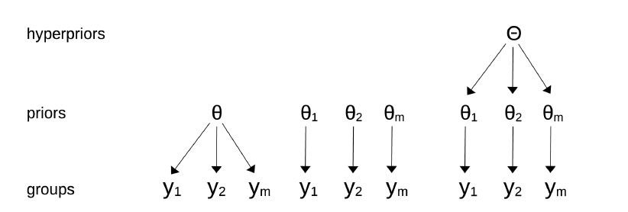
Hierarchical models
Does not allow sharing information.
Allows for sharing information between the groups, while also allowing the separate groups.

Slide 5
Hierarchical models
In hierarchical models, the parameters of the prior distributions are themselves given a prior distribution.
These higher-level priors are often called hyperpriors.
The parameters of the prior distributions belong to a common population of parameters.

Slide 6
Hierarchical models
We want to analyze the water quality in a city comprised of neighborhoods.
Option 1: Analyze the water quality in each neighborhood separately.
We obtain a more detailed view of the problem and averaging can cause us to lose information.
Option 2: Combine the data from all the neighborhoods.
We obtain a bigger sample size and hence a more accurate estimation.

Slide 7
Hierarchical models
Option 3: Hierarchical model.
Water samples from three neighborhoods.
If the lead content is above a threshold – the water is contaminated.
For each neighborhood, we have 30 samples, where the value of the sample is 0 if it’s contaminated and 1 if it is good.

Slide 8
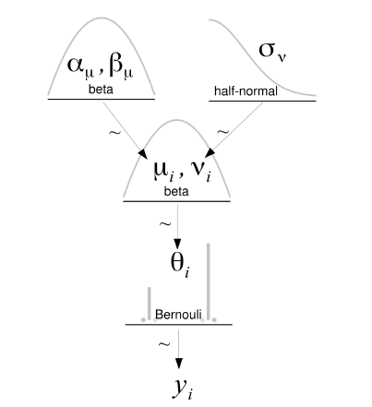

Hierarchical models
We are measuring the chance for a contaminated sample, or not -> binomial distribution.
We will use a hierarchical model to share information between the neighborhoods.
$$μ\sim Beta \left(α_{μ}, β_{μ}\right)$$
$$ν\sim HN\left(σ_{ν}\right)$$
$$θ_{i}\sim Beta\left(μ, ν\right)$$
$$y_{i}\sim Bernoulli(θ_{i})$$
Note: we are using the mean and precision (inverse of the standard deviation) in the beta prior.

Slide 9
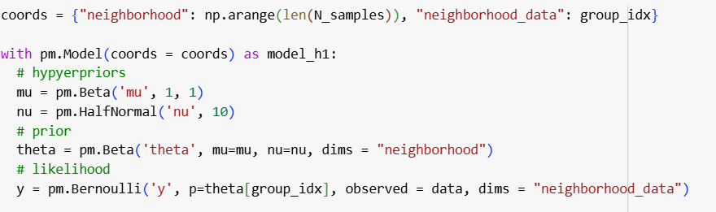
Hierarchical models

Slide 10
Hierarchical models
We are going to run the model on three versions of the data:
There are 18/30 contaminated water samples in all three neighborhoods.
There are 3/30 contaminated water samples in all three neighborhoods.
There are 3/30 contaminated water samples in two neighborhoods and 18/30 in one.

Slide 11
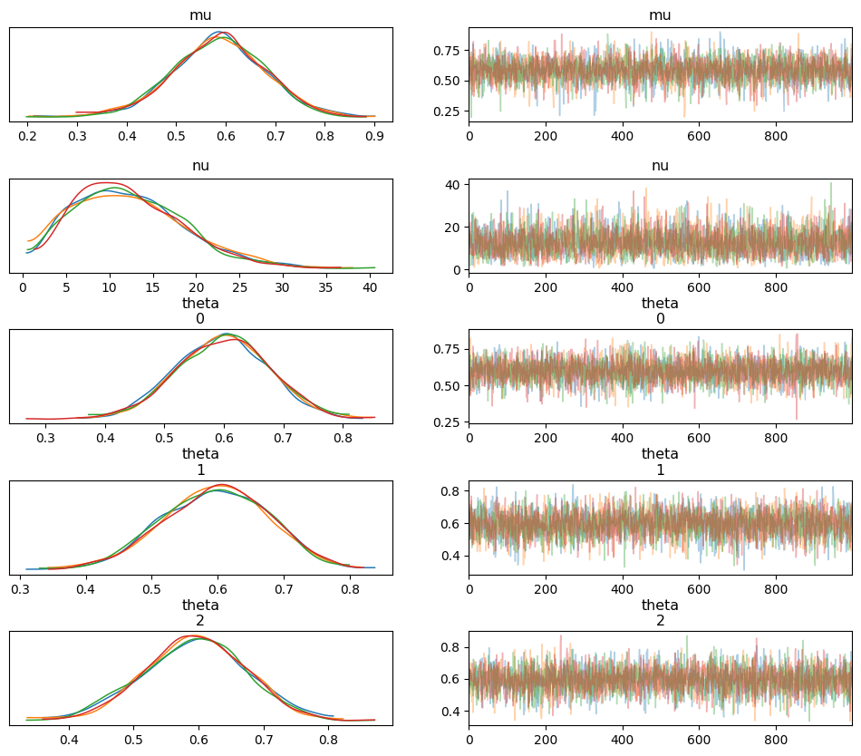
Hierarchical models
Examine the posterior distributions for the prior parameters (version 1).

Slide 12
Hierarchical models
For the theta
They all look very similar, which is expected as the data for the three neighborhoods was the same.

Slide 13
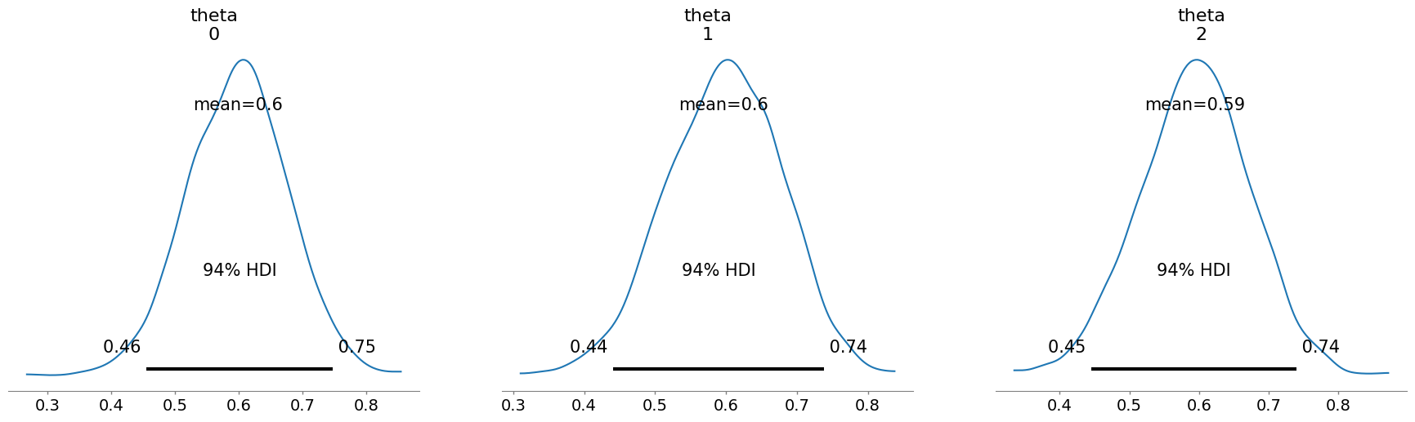
Hierarchical models
Mean and HDI

Slide 14
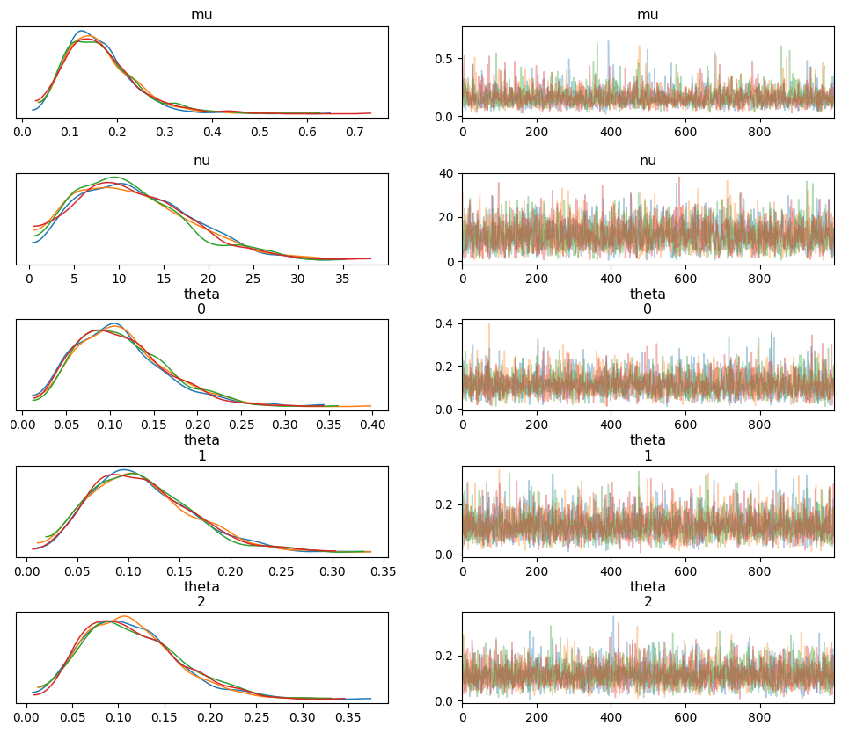
Version 2:

Slide 15
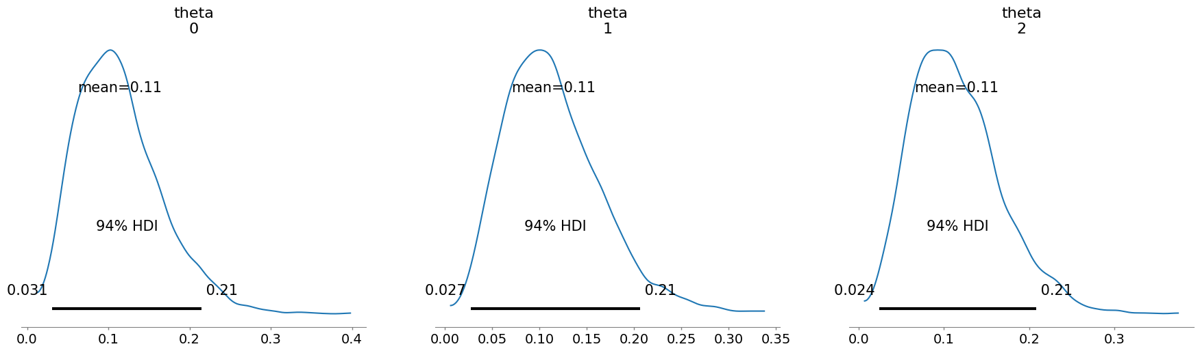
Hierarchical models
Mean and HDI

Slide 16
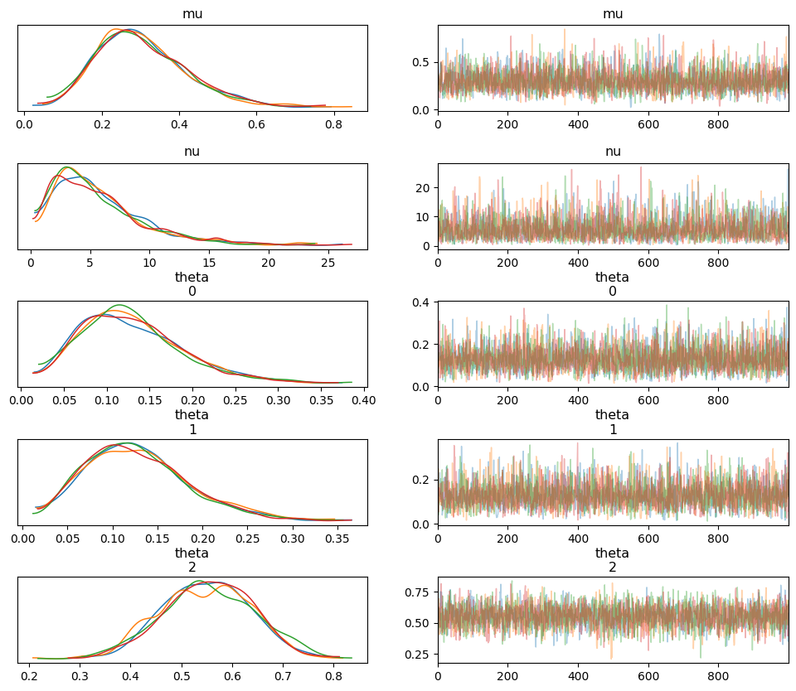
Version 3:

Slide 17
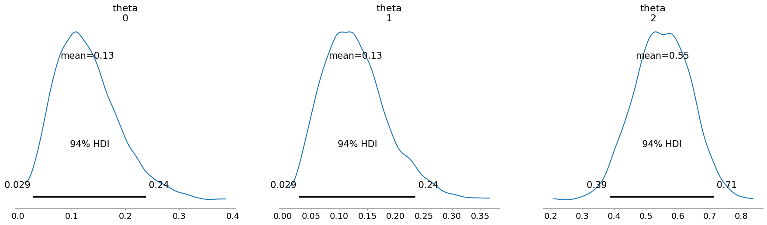
Hierarchical models
Mean and HDI

Slide 18
Shrinkage
In version 3, we would expect to see mean values of 0.11 for the neighborhoods with three contaminated samples and 0.6 for the neighborhood with 18 contaminated samples.
Instead, we got mean values of 0.13 for the neighborhoods with three contaminated samples and 0.55 for the neighborhood with 18 contaminated samples.
This is called shrinkage.
The estimates have shrunk toward the common mean due to each group informing the rest, and each group being informed by the estimation of the others.

Slide 19
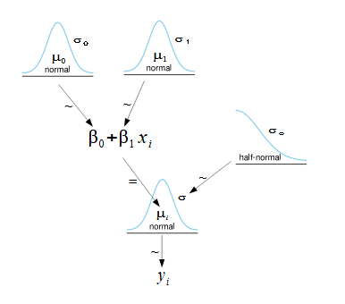

Simple Linear Regression
Review: We began to look at a case in which the mean depends on another variable.
Average height as a function of age.
$$y_{i}\sim N\left(μ_{i}, σ\right)$$
$$μ_{i}=β_{0}+β_{1}x_{i}$$
$$β_{0}\sim Prior0(θ_{0})$$
$$β_{1}\sim Prior1(θ_{1})$$
$$σ\sim Prior2(θ_{σ})$$

Slide 20
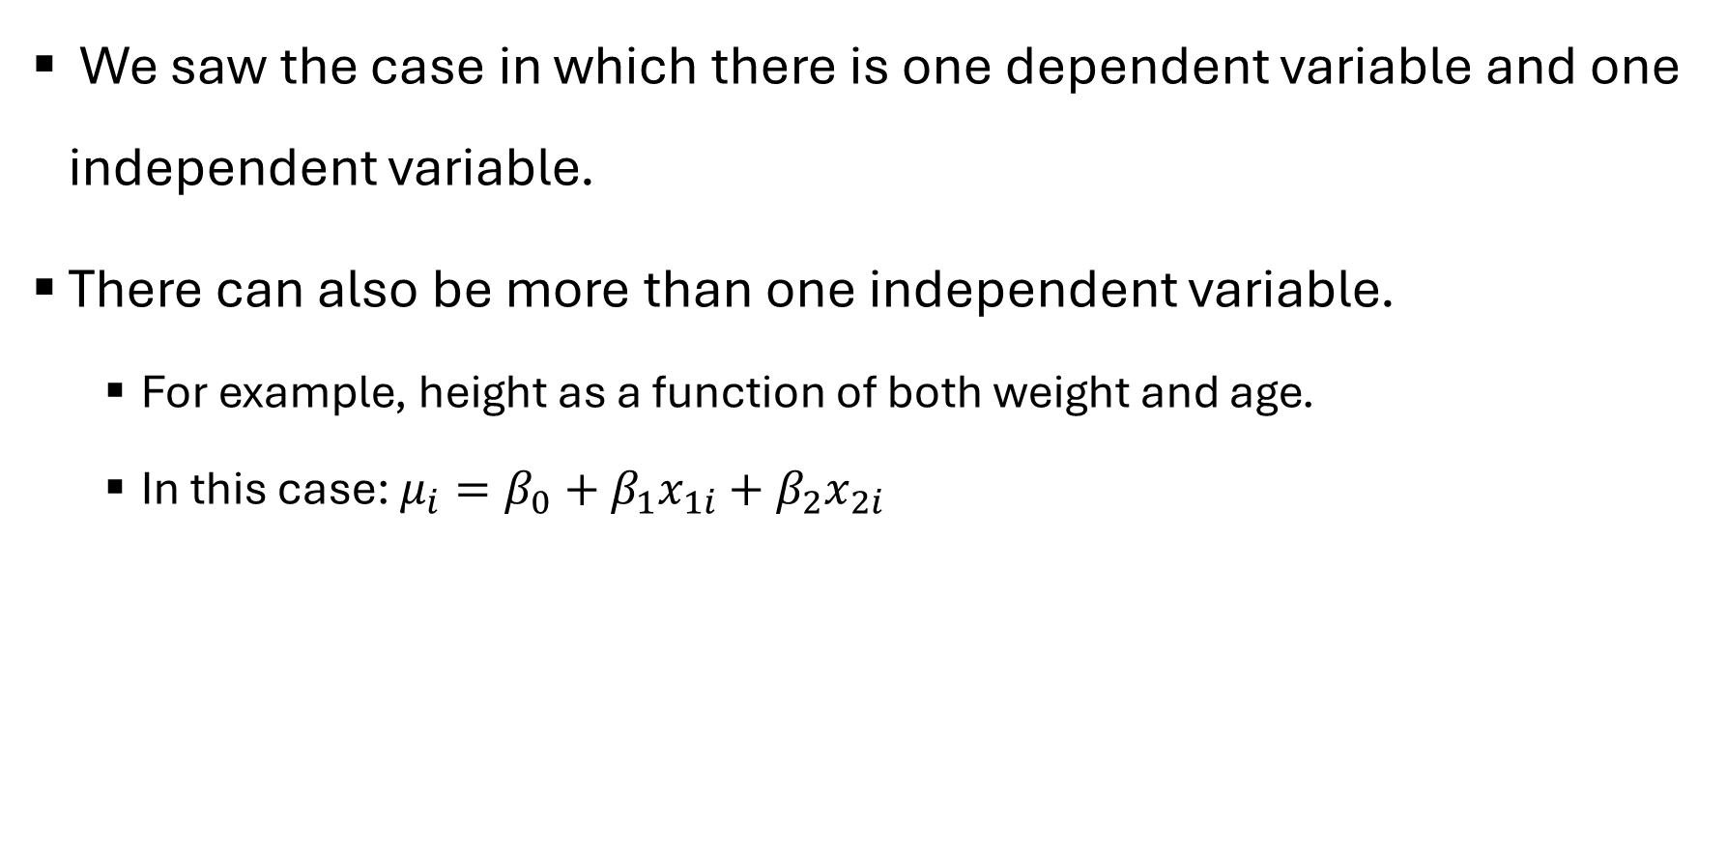
Multiple Regression
We saw the case in which there is one dependent variable and one independent variable.
There can also be more than one independent variable.
For example, height as a function of both weight and age.
In this case: $μ_{i}=β_{0}+β_{1}x_{1i}+$ $β_{2}x_{2i}$

Slide 21
Multiple Regression
Radon is a radioactive gas that can cause lung cancer and thus it is something that would be undesirable in a domicile.
The presence of a basement may increase the radon levels in a household as radon may enter the household more easily through the ground.
We have a dataset of the radon levels at homes in Minnesota as well as the county of the home, and the presence of a basement

Slide 22
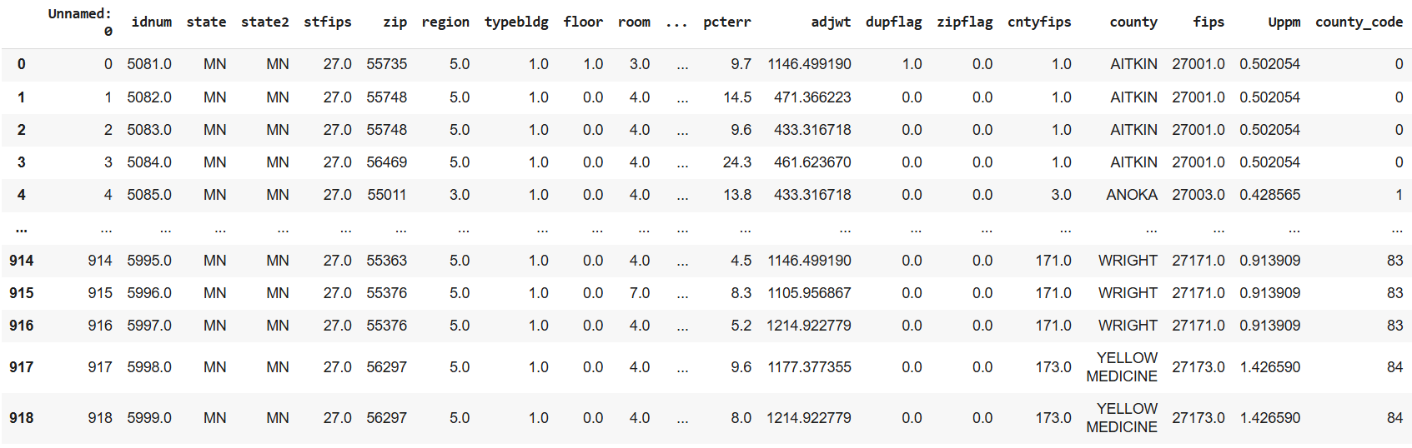
Multiple Regression
Load data

Slide 23
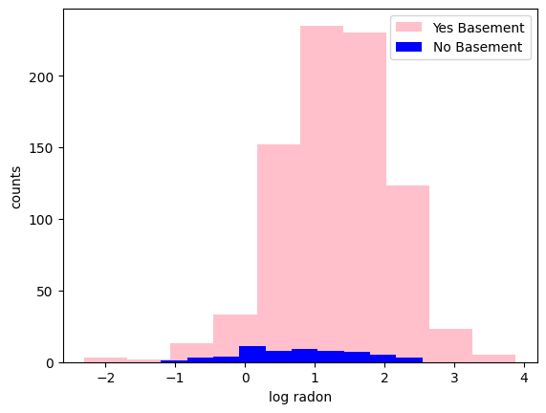
Simple Regression
Start with assessing the effect only of the presence of a basement on the radon levels.

Slide 24
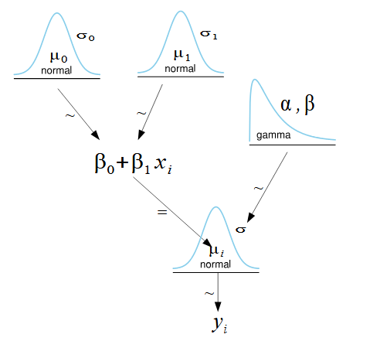
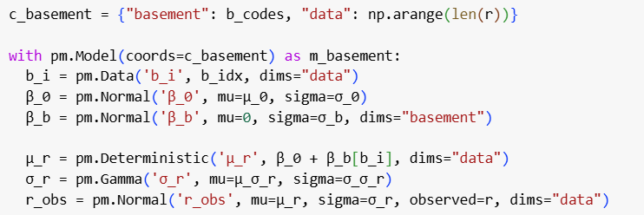
Simple Regression
Define our model

Slide 25
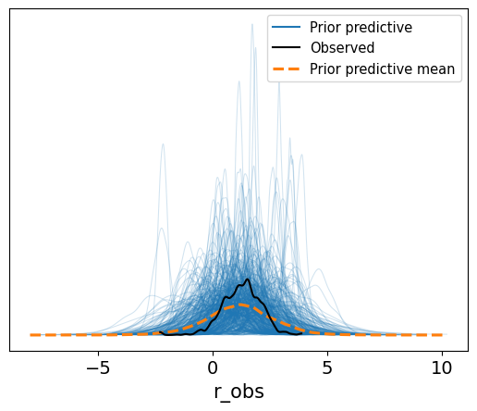
Simple Regression
Prior predictive check
Our priors look reasonable given the sampled datasets
Now we can sample

Slide 26
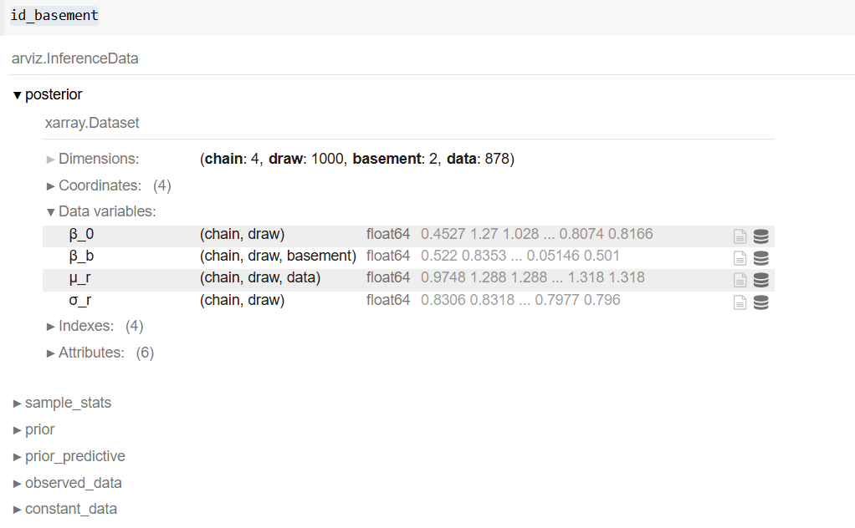
Simple Regression
Our inference data object

Slide 27
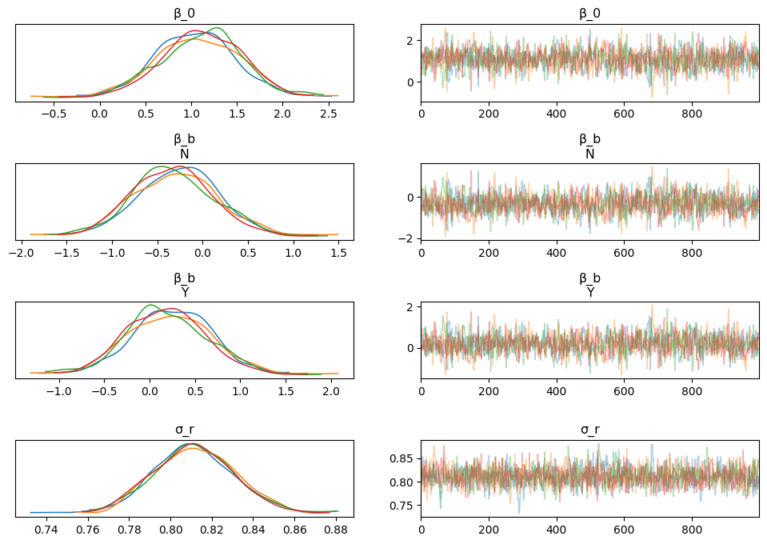
Simple Regression
Examine our sampling and posterior

Slide 28
Simple Regression
Examine our sampling and posterior
We can see that the four chains overlap.

Slide 29
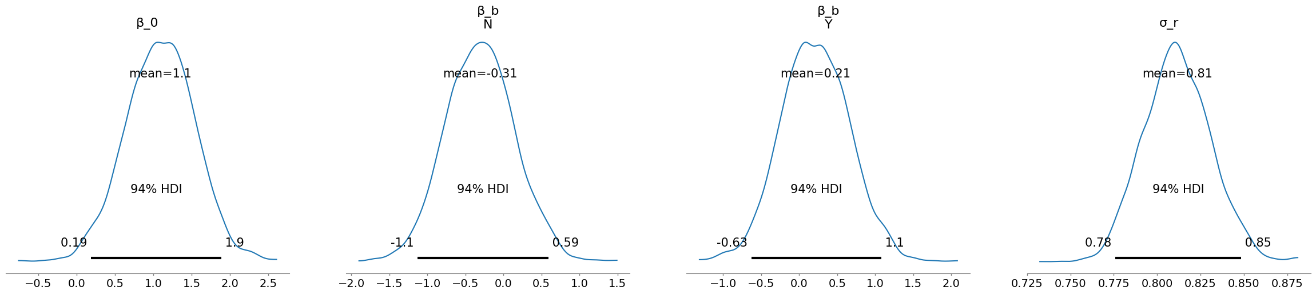
Simple Regression
Getting the HDIs

Slide 30
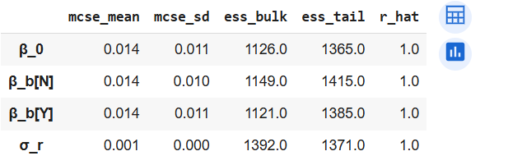
Simple Regression
And diagnostics
They fulfil the criteria we learned

Slide 31
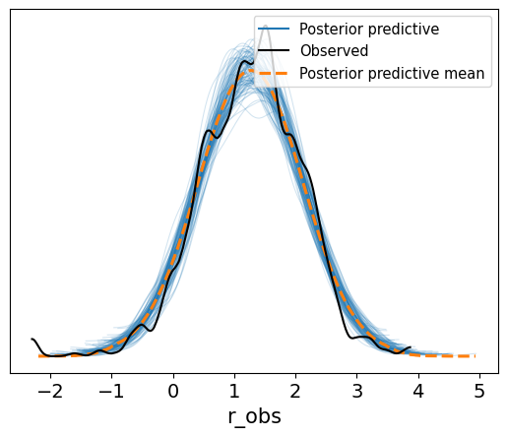
Simple Regression
Posterior Predictive Checks

Slide 32
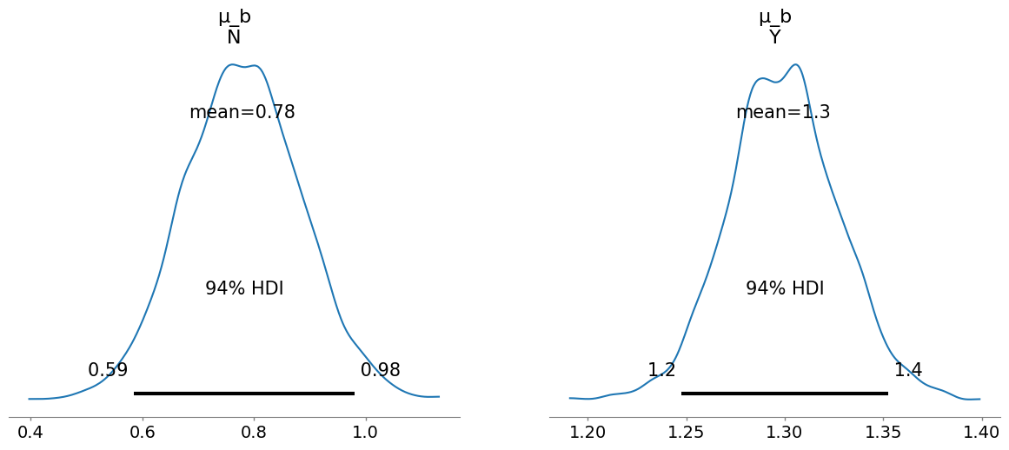
Simple Regression
Posterior Inference
The appears to be less radon in houses without basements.

Slide 33
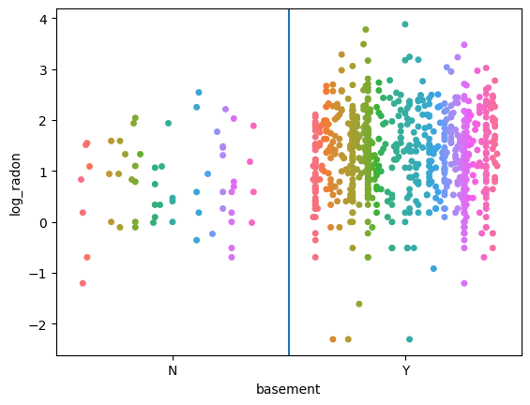
Multiple Regression
Now let’s add the effect of the county.
Examine data (colors show the different counties)

Slide 34
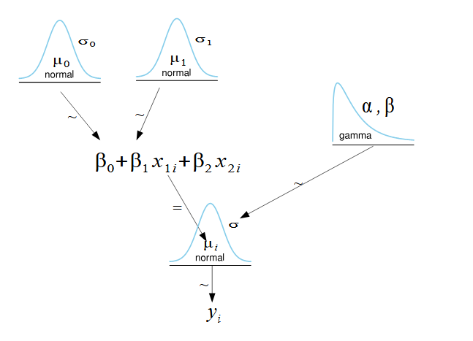
Multiple Regression
Create model for the multiple regression.
What we had for only the basement
Adding in county (still need prior)

Slide 35
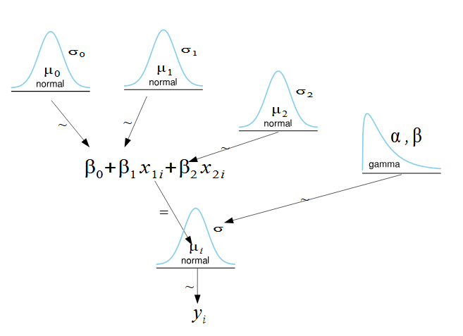
Multiple Regression
Create model for the multiple regression.

Slide 36
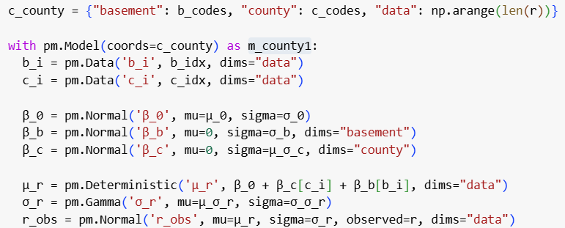
Multiple Regression
And the code:

Slide 37
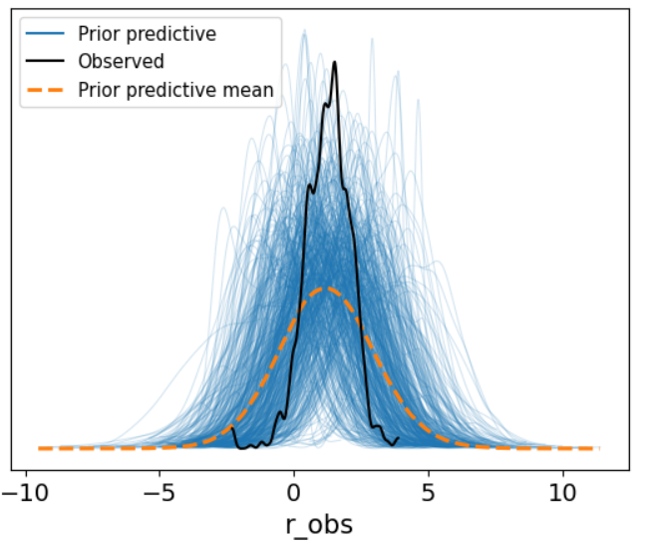
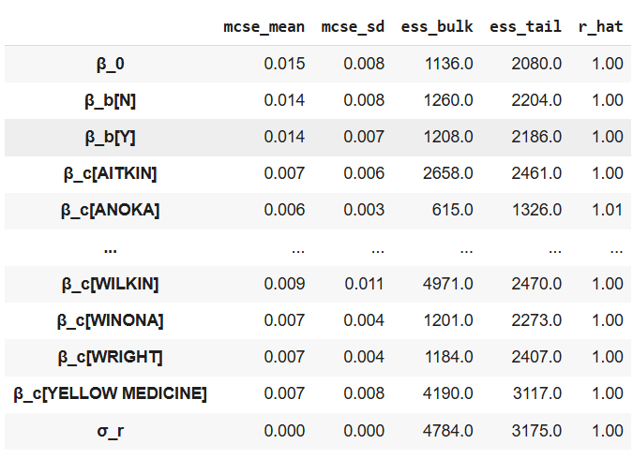
Multiple Regression
Now we do:
Prior predictive checks
Sample
Diagnostics

Slide 38
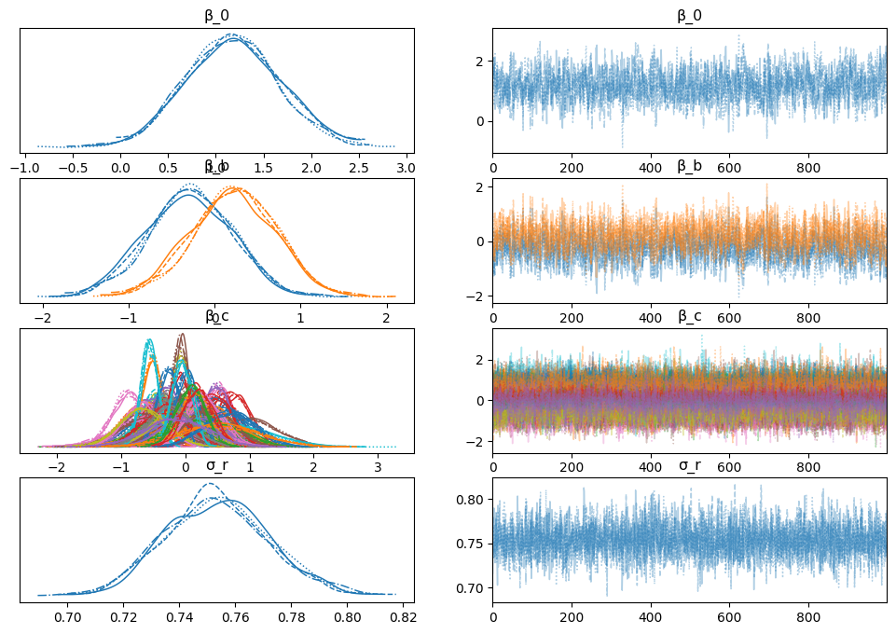

Slide 39
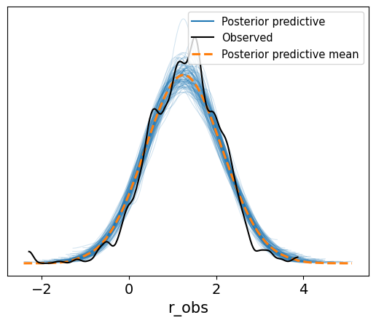
Multiple Regression
Posterior Predictive Check

Slide 40
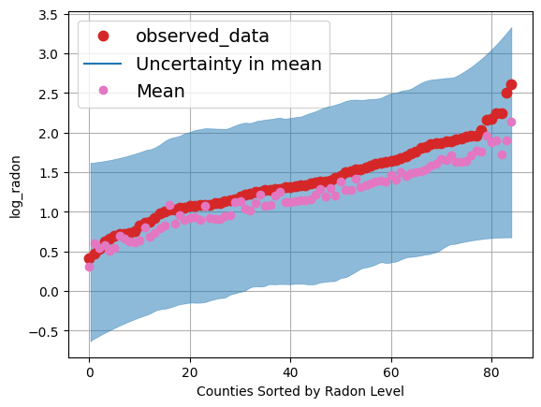
Multiple Regression
Examine the average levels of radon for the different counties and those predicted by the model.

Slide 41
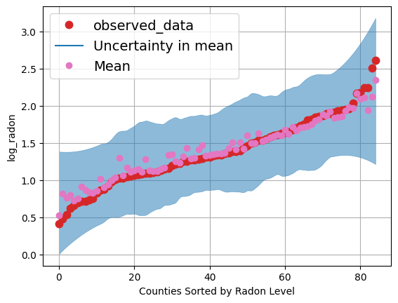
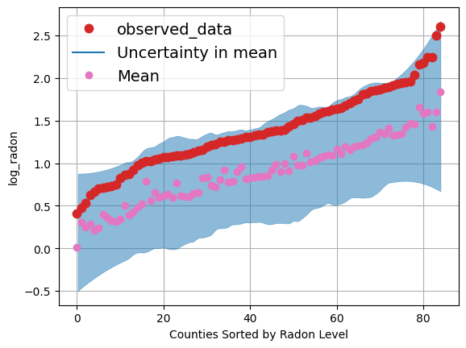
Multiple Regression
We can also separate for the estimates for houses with and without basements separately:
The mean of all the data is closer to that of only the basements (the majority of the data)
With Basement
Without Basement

Slide 42
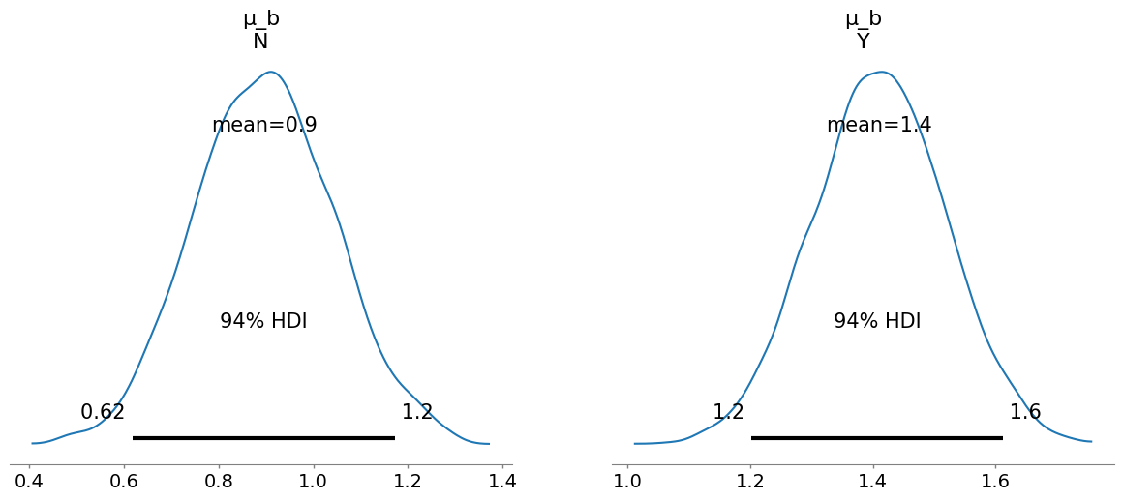
Multiple Regression
Effect of basement (increases radon levels)

Slide 43
Multiple Regression
We can compare between the results when including and not including the county data.
Not including
Including

Slide 44
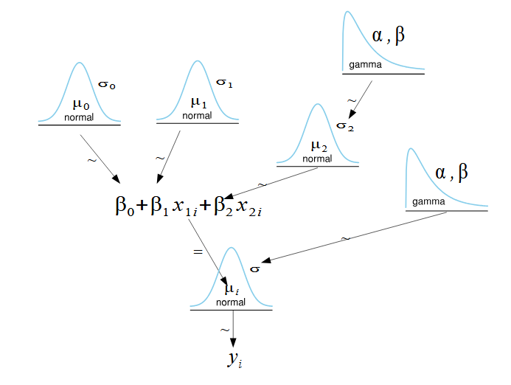
Multiple Hierarchical Regression
Create hierarchical model for the multiple regression.

Slide 45
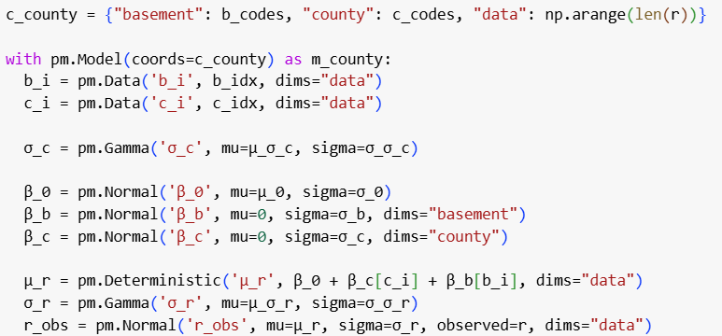
Multiple Hierarchical Regression
And the code:

Slide 46
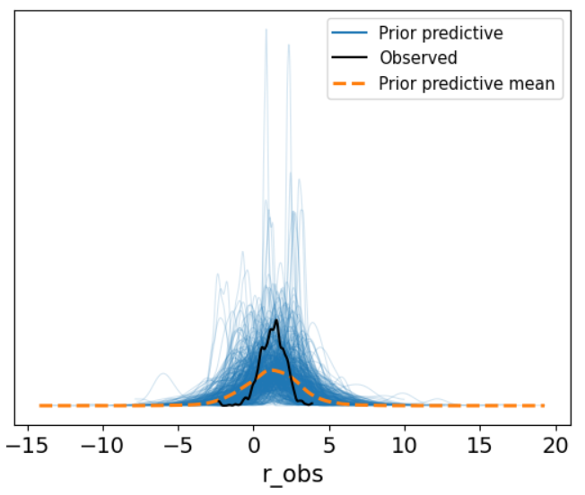
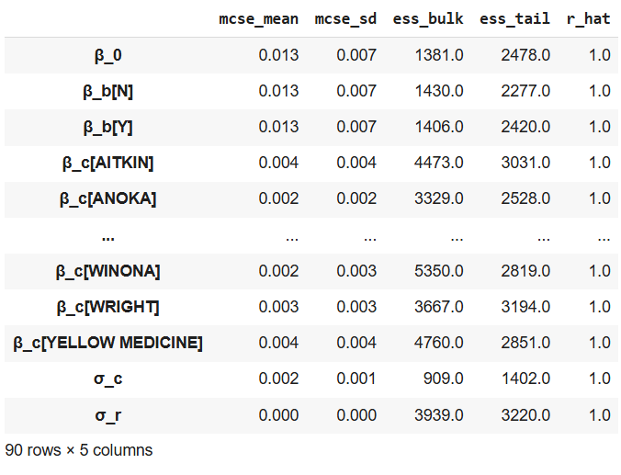
Multiple Hierarchical Regression
Now we do:
Prior predictive checks
Sample
Diagnostics

Slide 47
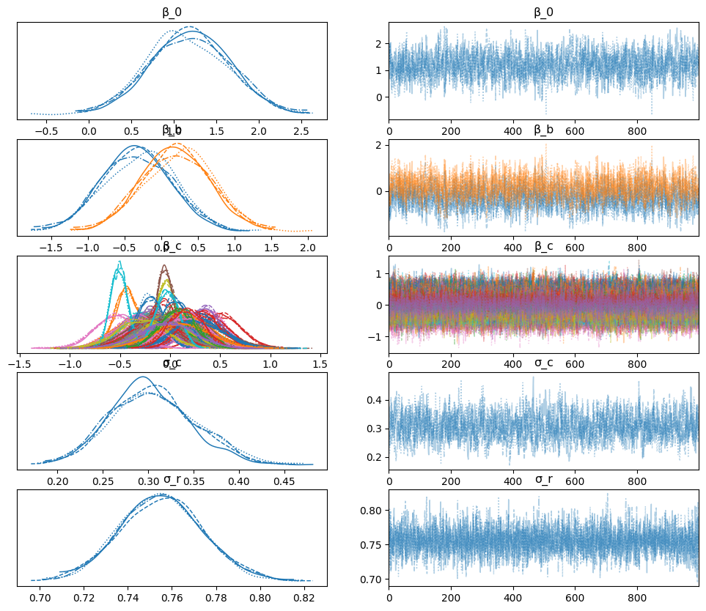

Slide 48
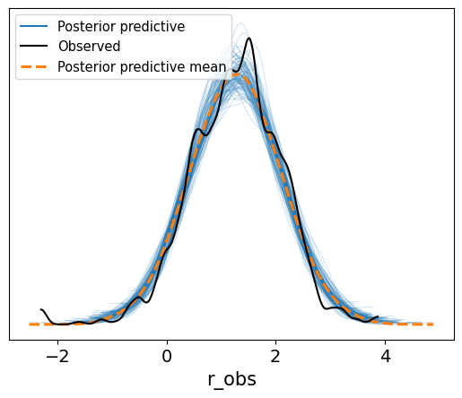
Multiple Hierarchical Regression
Posterior Predictive Check

Slide 49
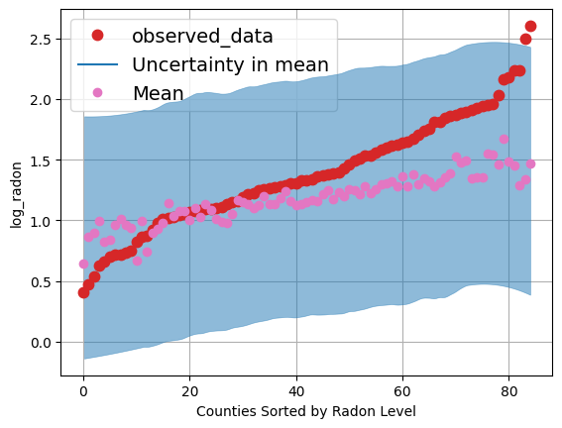
Multiple Hierarchical Regression
Average levels of radon for the different counties and those predicted by the model.

Slide 50
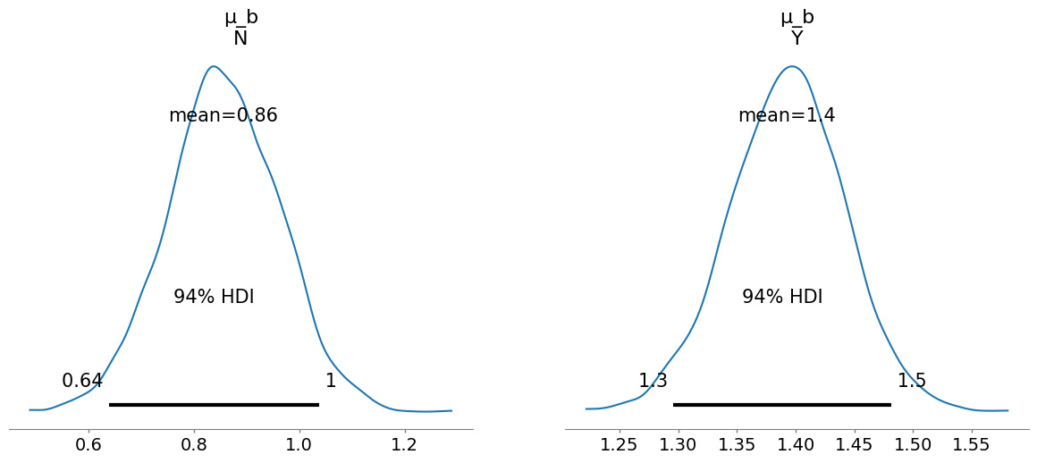
Multiple Hierarchical Regression
Effect of basement for this model:

Slide 51
Compare the Three Models
Only the basement
Multiple Regression
Multiple Hierarchical Regression

Slide 52
Compare the Models
The hierarchical linear regression led to:
A larger difference between the estimate of radon levels in houses with and without basements.
More certainty in the estimates (narrower HDIs).
This is true for both the comparison with the multiple regression (not hierarchical) model and the simple model including only basement information.

